Slide 1
Can ChatGPT Forecast Stock Price Movements? Return Predictability and Large Language Models
Alejandro Lopez-Lira, Yuehua Tang · University of Florida
Journal of Financial Economics, Vol. 184 (2026), 104335

Slide 2
Research Questions & Headline Findings
RQ1: Can an LLM predict the market’s immediate reaction to firm news?
RQ2: Do LLM scores predict the price drift that follows (underreaction)?
RQ3: Does this ability depend on model size, and on the type of news?
RQ4: What happens to predictability as LLMs are widely adopted?
93.3%
GPT-4 hit rate on the initial reaction (overnight news)
2.97
Annual Sharpe ratio of the GPT-4 drift strategy
6.54 → 1.22
Sharpe ratio decline, 2021 Q4 → 2024
Financial reasoning appears to be an emerging capability of large LLMs, and LLM adoption may make markets more efficient.

Slide 3
Method: Prompting GPT-4 to Score Headlines
News Headline
+ company name
GPT-4 Prompt
temperature = 0
YES / NO / UNKNOWN
+ one-sentence reason
GPT-4 Score
+1 / −1 / 0
Forget all your previous instructions. Pretend you are a financial expert. You are a financial expert with stock recommendation experience. Answer “YES” if good news, “NO” if bad news, or “UNKNOWN” if uncertain in the first line. Then elaborate with one short and concise sentence on the next line. Is this headline good or bad for the stock price of _company_name_ in the short term?
Headline: _headline_
Model: “gpt-4-0314” via the OpenAI API (data up to Sep 2021); temperature 0 for reproducibility.
Portfolios: scores averaged per firm-day → buy positive-score stocks, short negative-score stocks.
Comparison: 11 other models: GPT-1, GPT-2, BERT, BERT-Large, BART-Large, DistilBART-MNLI, GPT-3.5, FinBERT, Llama2-7B/13B/70B.
Basic models (GPT-1/2) cannot follow instructions, so they get adapted prompts.

Slide 4
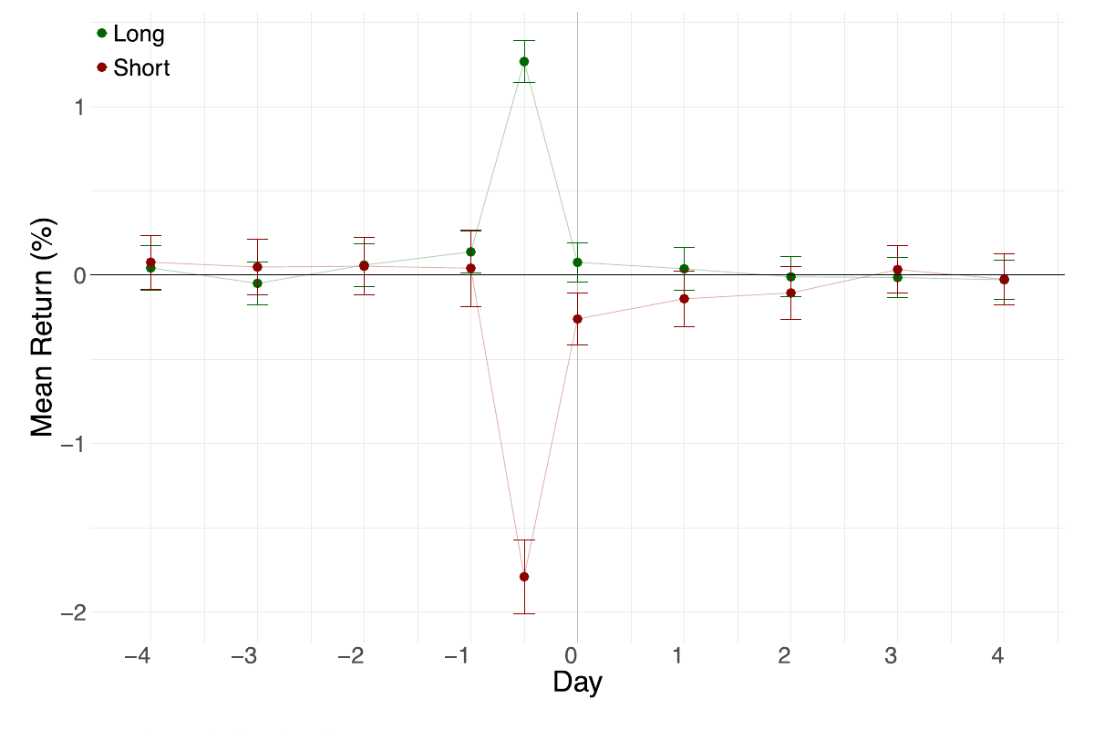
Result 1: GPT-4 Predicts the Reaction and the Drift (Fig. 1)
Overnight news: stocks with positive GPT-4 scores gain +1.27% at the open; negative ones fall −1.79%.
Intraday news: +1.33% vs. −3.11% within 15 minutes.
Drift: after the initial jump, prices keep moving in GPT-4’s direction for 1–2 days.
The drift is stronger after negative news, consistent with costly short-selling.
Fig. 1. Overnight news returns around release; green = Long (good news), red = Short (bad news).
93.3%
Hit rate, overnight initial reaction
88.8%
Hit rate, intraday initial reaction
2.97
Sharpe, overnight drift strategy
2.63
Sharpe, intraday drift strategy

Slide 5
Comparing 12 Language Models (Table 5)
Model | Est. parameters | Hit rate: Initial | Hit rate: Drift | Sharpe (drift L-S)
GPT-4 | ≈1.76T (unconfirmed) | 0.93 | 0.58 | 2.97
GPT-3.5 | ≈175B (unconfirmed) | 0.93 | 0.56 | 1.66
FinBERT | 110M | 0.90 | 0.48 | −0.33
DistilBART-MNLI | < 400M | 0.87 | 0.56 | 1.26
BART-Large | 400M | 0.86 | 0.57 | 1.05
Llama2-70B | 70B | 0.86 | 0.53 | 0.97
Llama2-13B | 13B | 0.86 | 0.52 | 0.78
BERT-Large | 336M | 0.70 | 0.50 | 1.05
Llama2-7B | 7B | 0.66 | 0.48 | −0.43
BERT | 110M | 0.64 | 0.46 | −0.47
GPT-2 | 124M | 0.55 | 0.53 | −0.11
GPT-1 | 117M | 0.53 | 0.48 | −0.64
RavenPack (benchmark) | – | 0.88 | 0.60 | 2.50
Ability rises with model size. FinBERT reads tone well (90%) but has no drift signal, which is relevant to FinBERT2.

Slide 6
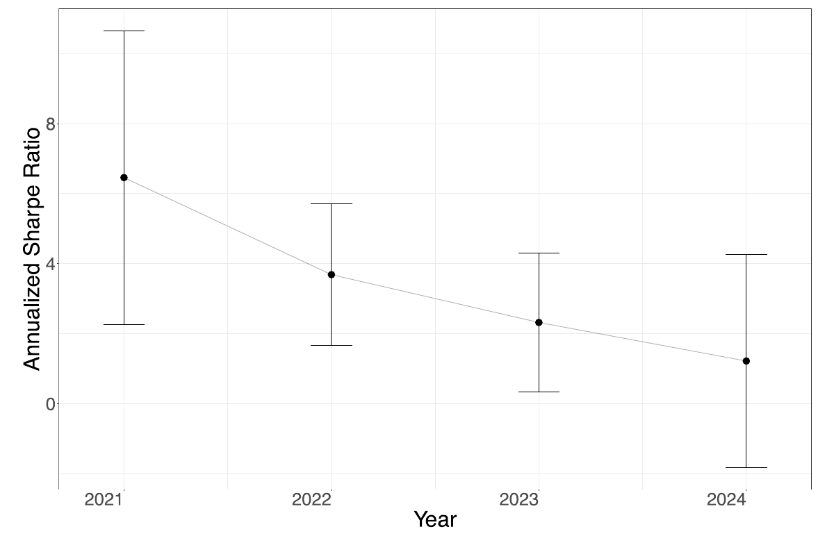
Market Efficiency: Predictability Falls as LLMs Spread (Fig. 8)
ChatGPT launched in Nov 2022; generative-AI use by asset managers rose sharply from 2022.
The GPT-4 strategy’s Sharpe ratio falls steadily over the sample.
Consistent with the model: more investors using capable LLMs → faster price adjustment.
Caveat: suggestive evidence only; other market changes could also play a role.
Fig. 8. Year-by-year annualized Sharpe ratio of the overnight-news strategy, with 95% intervals.
6.54
2021 Q4
3.68
2022
2.33
2023
1.22
Jan – May 2024

Slide 7
Conclusion
GPT-4 reads the economic meaning of headlines without financial training: ≈90% hit rate on initial reactions.
Its scores predict 1–2 days of drift, especially for small stocks and negative news.
Markets are efficient for simple news (earnings) but underreact to complex news (insider trades).
Financial reasoning is an emerging capability: only large models produce profitable signals.
Falling Sharpe ratios suggest LLM adoption is making markets more efficient.
A theoretical model links LLM capacity, investor inattention, and limits to arbitrage.
LLMs are both a forecasting tool and a new lens for studying how markets process information.

